Slide 1
TV SHOWS & MOVIES NETFLIX
Clelia Chelmi
Katerina Psallida
Lilly Kolliniati

Slide 2

TABLE OF CONTENTS
01
02
03
04
Introduction
Analysing the data
Business case
Areas of investigation
Genres – Duration Directors
Summary
Closing
Conclusions
Recommendations
Q&A
Appendix

Slide 3

01
Introduction

Slide 4



Business case
Who we are: Film industry consultants
Audience:
Netflix management teams
Film and movie producers
Advertising agencies
Goal: Recommendations for Netflix’s next year’s catalogue

Slide 5
Areas of investigation
Genres
Content type
Most popular genres
Further analysis on a move or show level
Components of a successful film or a successful show.
Director
Most popular director

Slide 6
02
Analysing the data

Slide 7
I.
Genres Analysis

Slide 8


Subset explanation
We have created a subset with the content release since 2015. The popular streaming platform started gaining traction after 2015. Since then, the amount of content added has been increasing significantly. Therefore we performed analysis on data acquired from 2015 onwards.

Slide 9
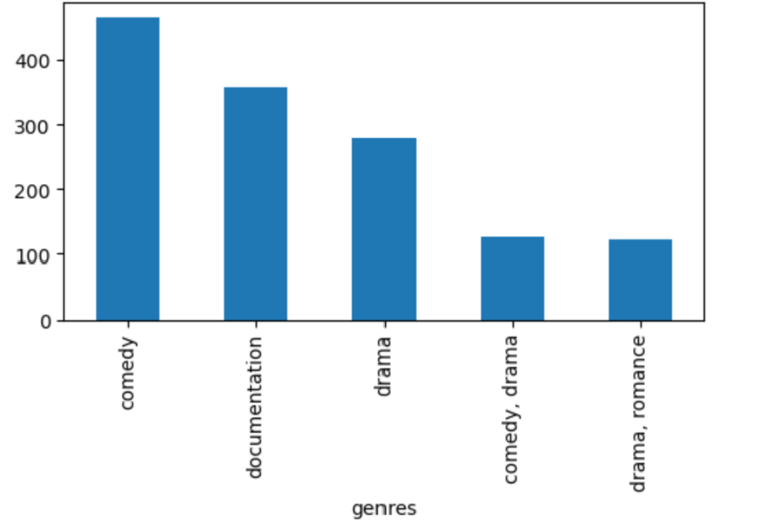
Genres Most popular genres in the catalogue

Slide 10
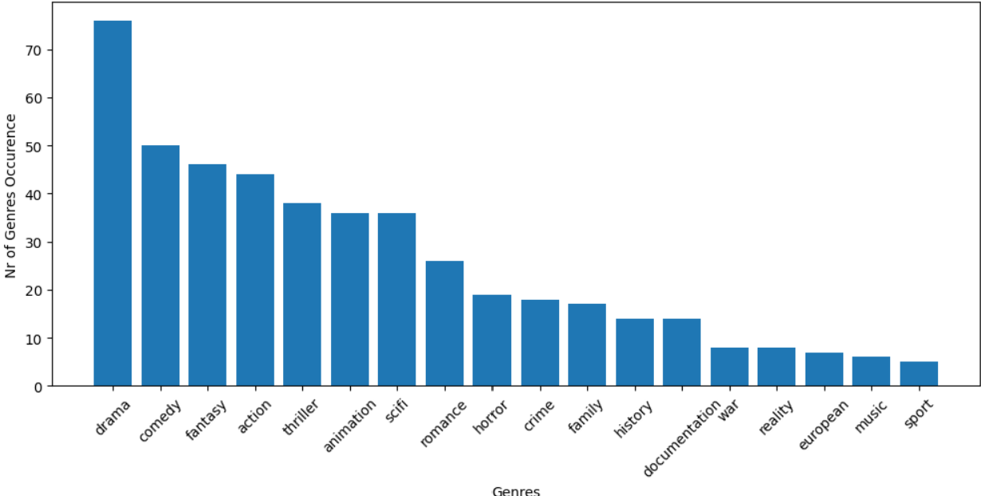
Genres Most highly rated based on IMDB score

Slide 11
Our analysis showed that comedies and documentaries take the top two spots, whereas the bottom three positions are occupied by genres such as drama, comedy-drama and drama- romance movies and TV shows. We analyzed the distribution of movie &amp; TV-shows genres and their impact on the IMDB score. The top 10 most common genres are drama, fantasy, comedy, thriller, action, animation, romance, drama, horror and sci-fi. We concluded that content creators working for Netflix should continue producing drama, comedy and romance movies/TV-shows, with a focus on drama genre as this is associated with high IMDB scores; fantasy, thriller and action movies should be carefully considered for production.

Slide 12
II.
Content type Analysis

Slide 13
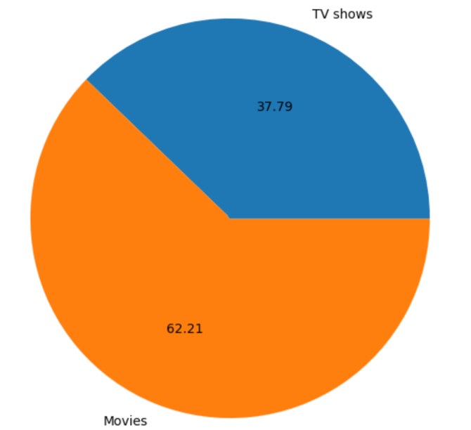
Content type

Slide 14
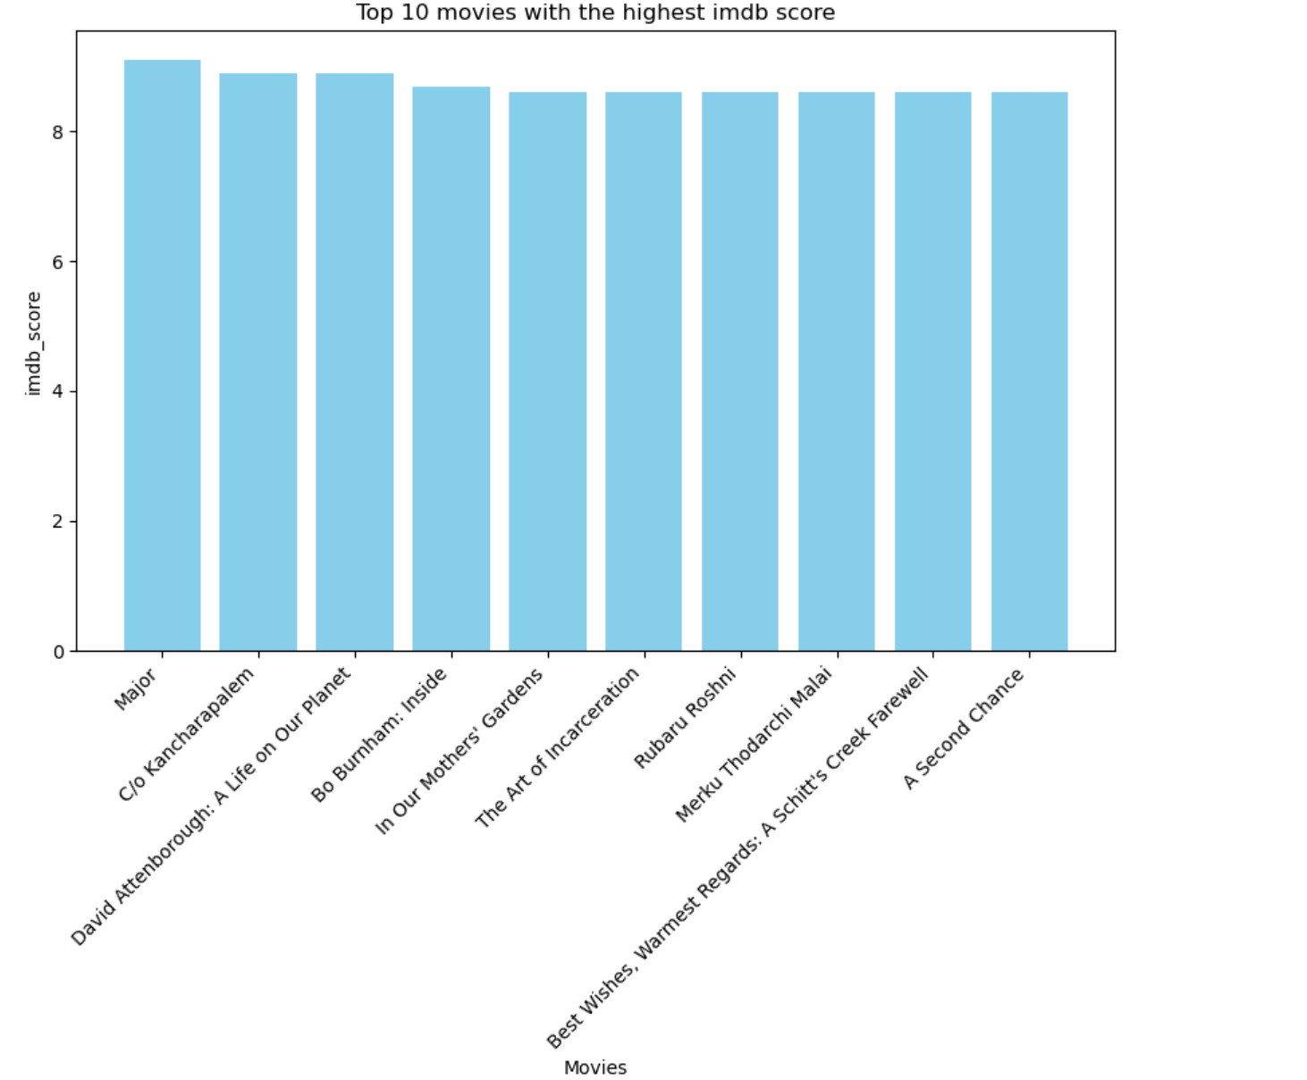
Content type – Movies Most popular films based on IMDB score

Slide 15
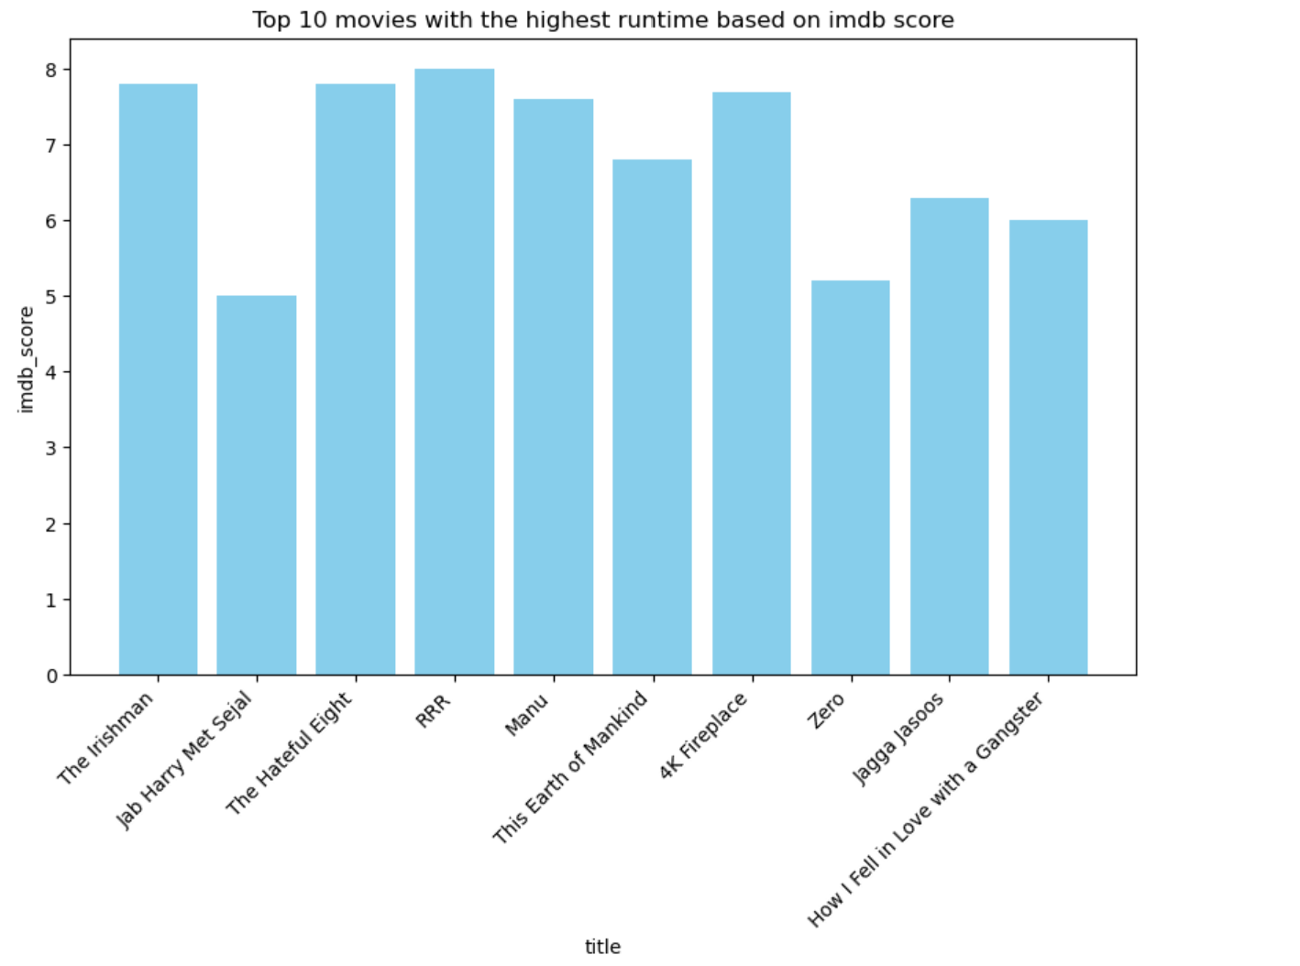
Content type – Movies Film duration and ratings
Film duration > 3hours: 7 films
Film duration > 2hours: 441 films
80% of films have duration < 2hours

Slide 16
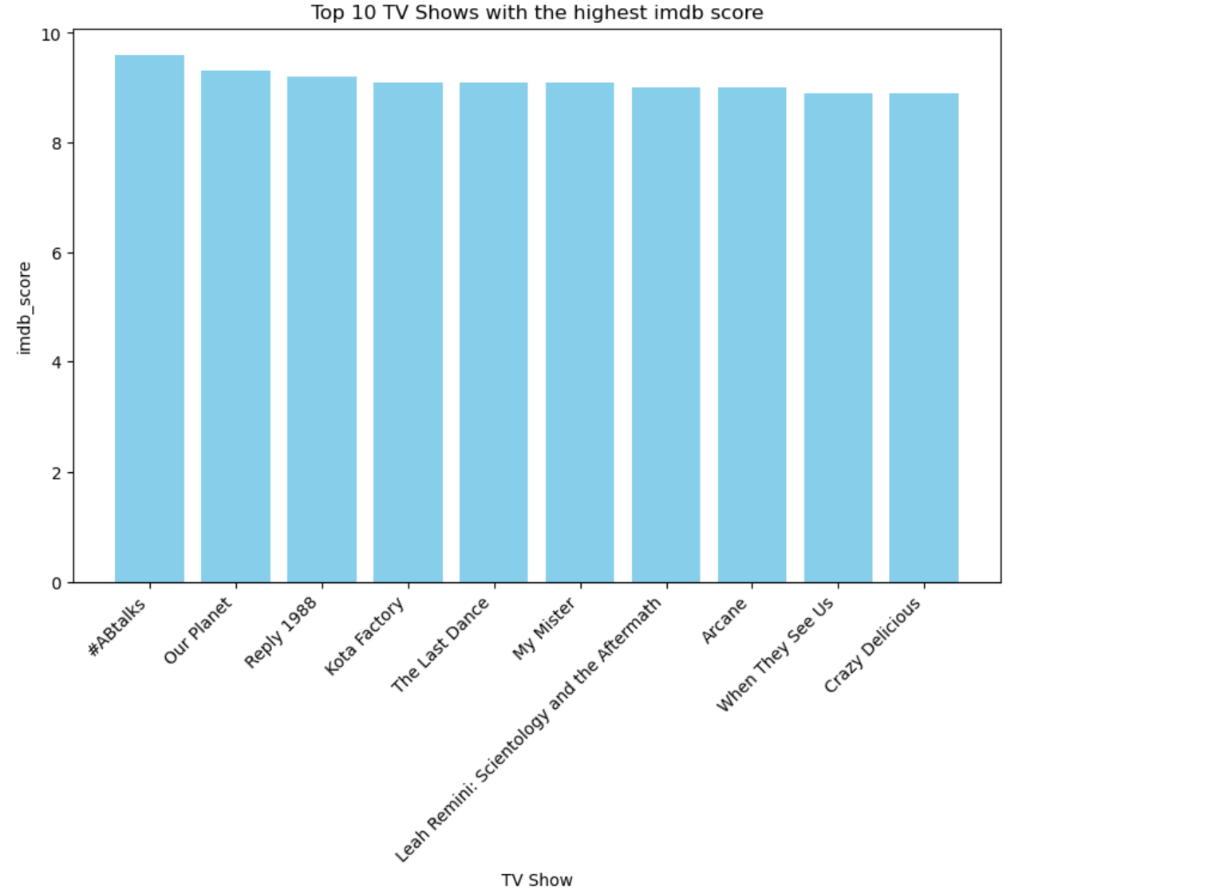
Content type – TV Shows Most popular TV Shows based on IMDB score

Slide 17
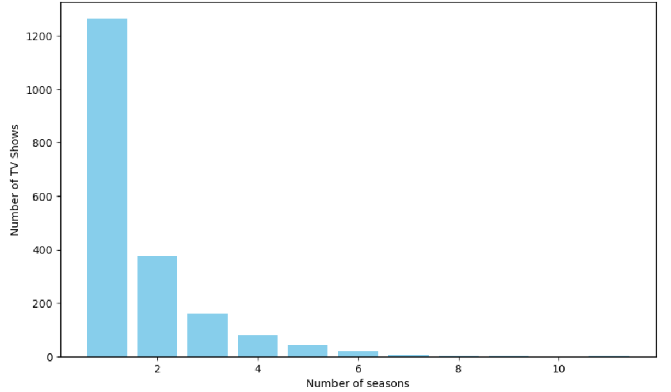
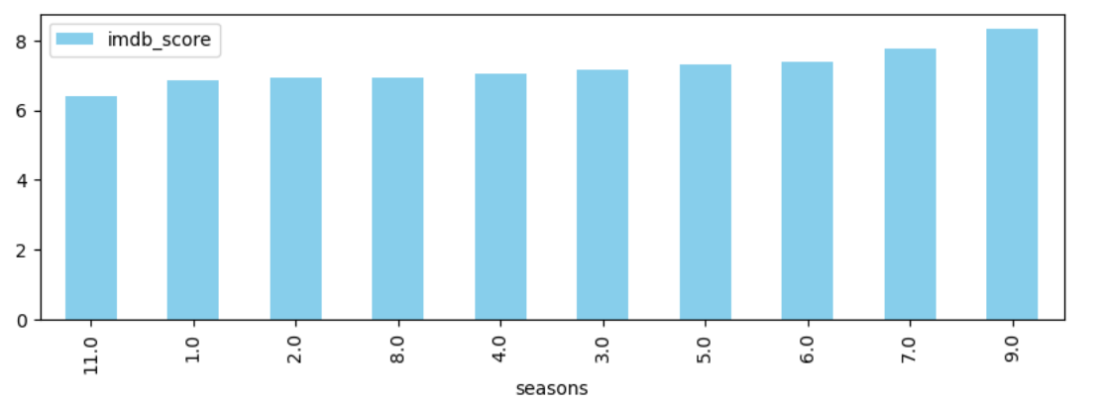
Content type – TV Shows TV Shows seasonality and ratings

Slide 18
Approximately 62% of the titles available on Netflix belong to the category of movies, while only around 38% fall under the TV shows category. We found the top 10 of TV-shows and the top 10 of movies, based on their IMDB score. Most of the TV-shows available on Netflix, ran for 1 season. Only a few TV shows extend beyond a single season. We observe that the movies with a runtime of about 180 minutes have an IMDB score between 6.5 and 8, therefore Netflix may need to invest in creating movies with less than 180 minutes runtime.

Slide 19
III.
Director Analysis

Slide 20
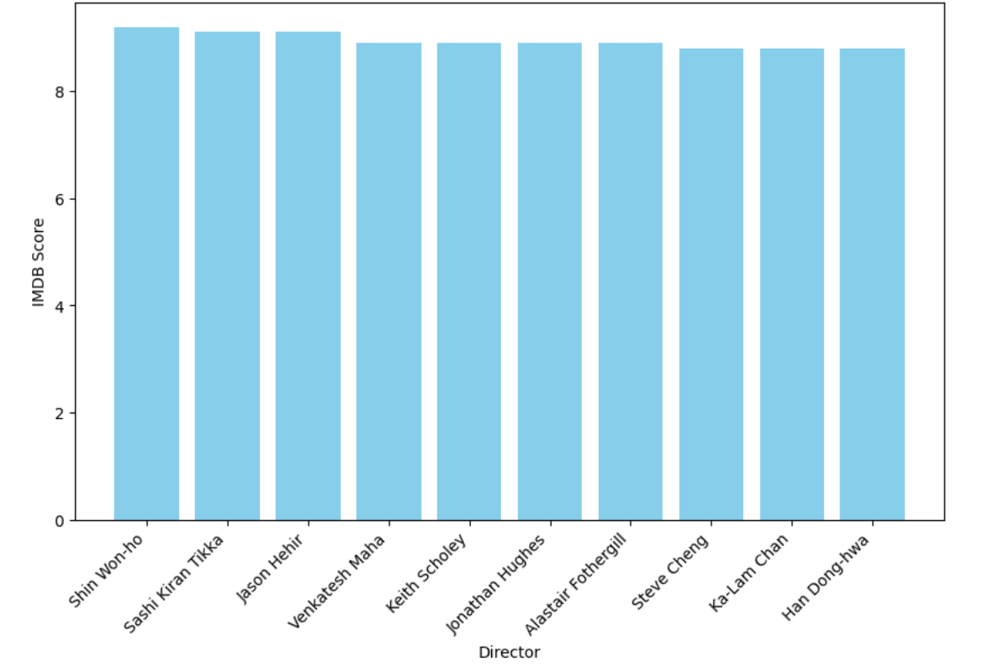
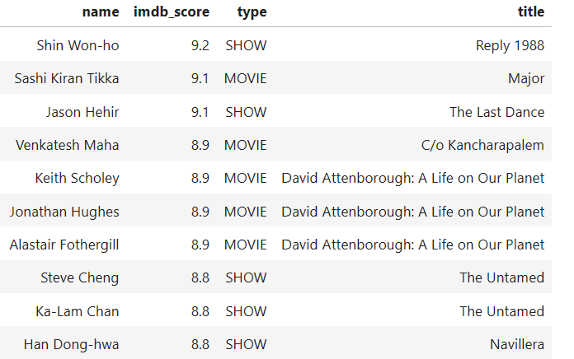
Directors Most popular directors based on IMDB score The most popular directors on Netflix, are mainly international, but their productions are very well -known series/films.

Slide 21
03
Summary

Slide 22
Conclusions
Based on this analysis we concluded the following:
Netflix content is based more on movies, than TV Shows.
Most titles are Dramas.
Most popular movies keep us in front of the screen for more than 120 minutes and TV
Shows have only one season.
International directors based on IMDB scores stand out in film and TV-shows production.
Netflix started gaining traction after 2015.

Slide 23
04
Closing

Slide 24
APPENDIX
Resources
https://www.kaggle.com/datasets/victorsoeiro/netflix-tv-shows-and-movies
Disclaimers
IMDB score values are as depicted on the dataset and not any weighted value
Github links
CC link:
KP link:
Lilly Kolliniati: https://github.com/lillykolliniati/Git-project-1-

Slide 25
THANKS!
Do you have any questions?
Please keep this slide for attribution

